Slide 1
Gila Breath Camp - Milestone 2
Madison Wikoff, Will Hurwitz, Nicholas Knirimen, Christopher Pollock
Notes:
Nicholas

Slide 2
Our Main Focus:
At Milestone 1, we showed our GUI template for the application.
For Milestone 2, our focus was to:
Prioritize customer’s ability to manage Gila Breath Camp campers and their information.
Notes:
Will

Slide 3
Our Plan After
Milestone 1
We wanted to attempt to get at least one or two of the application’s primary functions working, these primary functions being:
Adding Camper Information to DataBase
Searching for Camper in DataBase
Sorting Campers into Bunks
We also wanted to get the GUI functional within one file, which we accomplished by adding buttons to go between the Options and individual pages.
Tasks were distributed evenly among our team.
Notes:
Chris

Slide 4
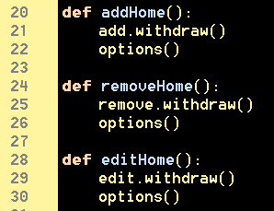
Working Features:
GUI within one file with back buttons
Notes:
Madison

Slide 5
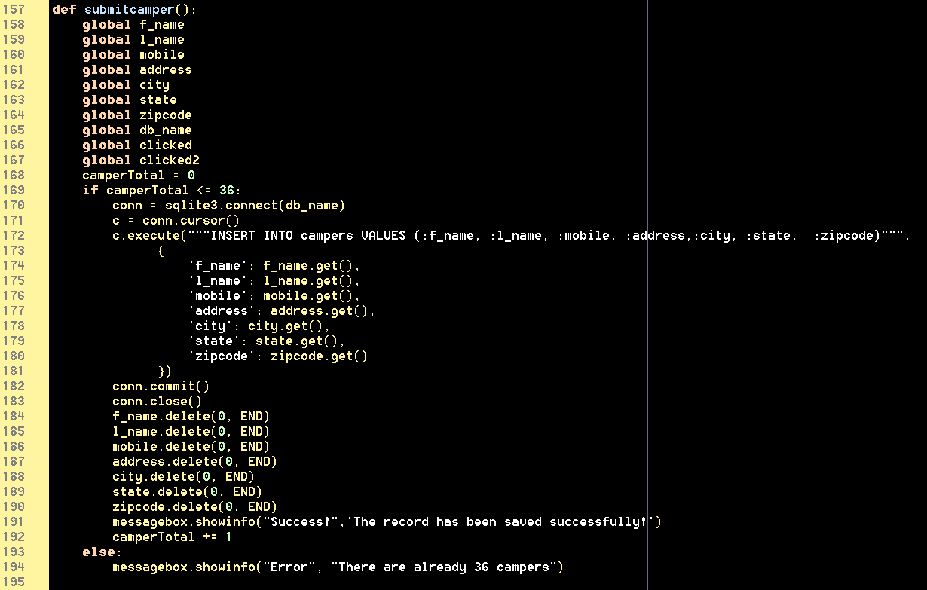
Working Features:
Add Camper Information
Notes:
Chris

Slide 6
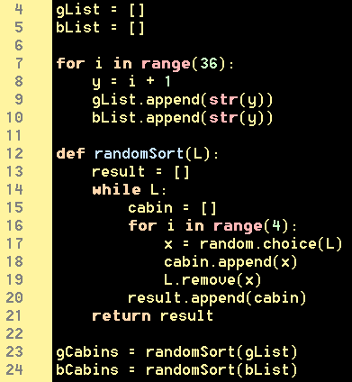
Working Features:
Backbone for Camper Sorting
Notes:
Nicholas

Slide 7
Future Development for
Gila Breath Camp
Functions that are in the works.
Notes:
Will

Slide 8
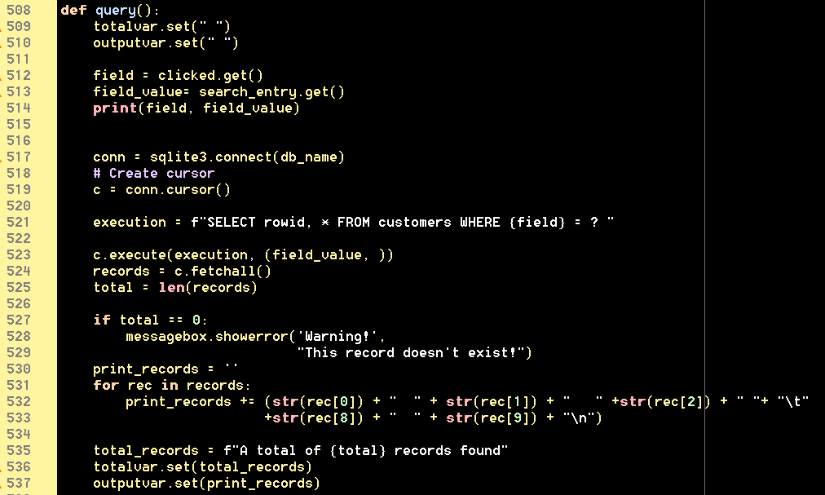
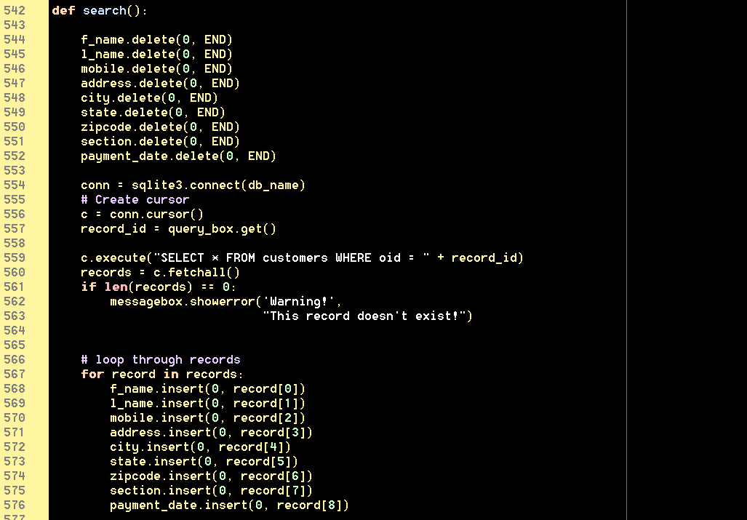
Future Development:
Search Functions
Notes:
Will

Slide 9
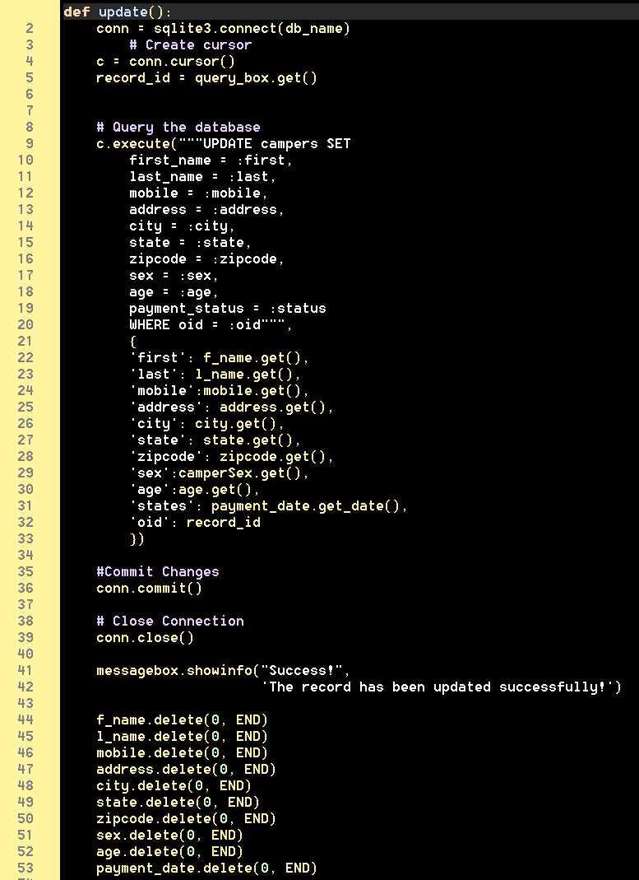
Future Development:
Update Camper Information
Notes:
Madison

Slide 10
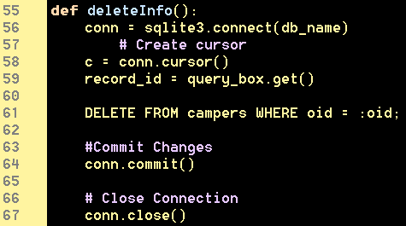
Future Development:
Delete Camper Information
Notes:
Madison

Slide 11

Questions?

